Slide 1
CHAPTER 7 DEADLOCKS
07/04/202
1

Slide 2
Chapter Contents
Resources
Introduction to deadlocks
Deadlock detection and recovery
Deadlock Avoidance
Deadlock Prevention
4/7/2023

Slide 3
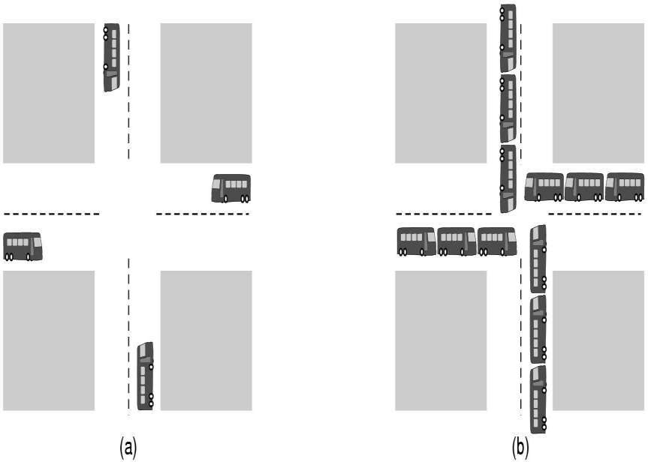
Deadlock-Example
Two or more busses are interacting, they get themselves into a stalemate situation they
cannot get out off.
4/7/2023

Slide 4
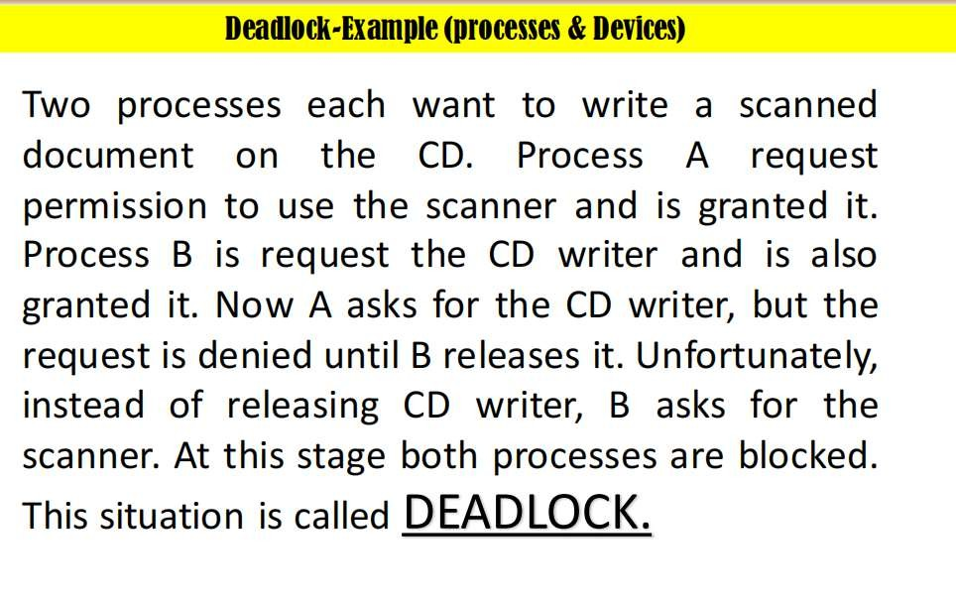
4/7/2023

Slide 5
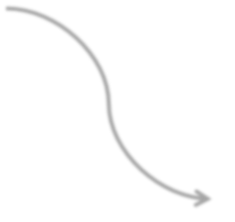





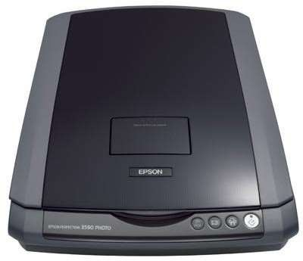



Deadlock-Example (Processes & Devices)
Process
A
Process
B
R2 Denied
R1 Granted
R1 Granted
R2 Denied
Deadlock
4/7/2023

Slide 6
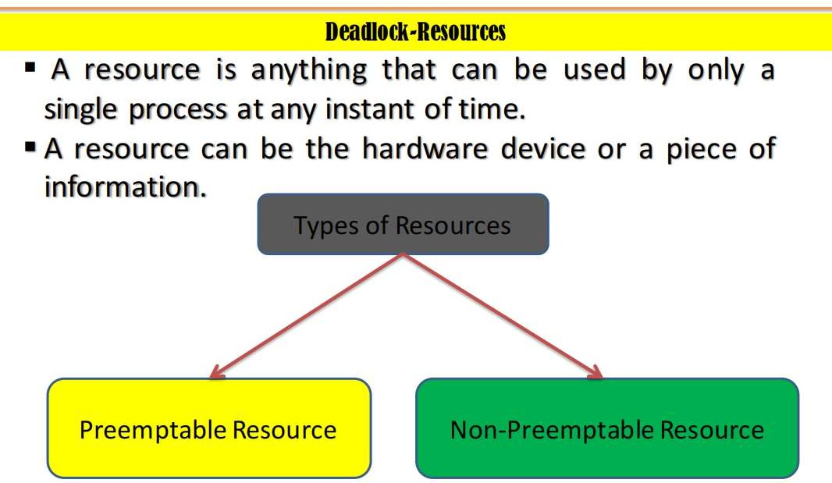

Slide 7
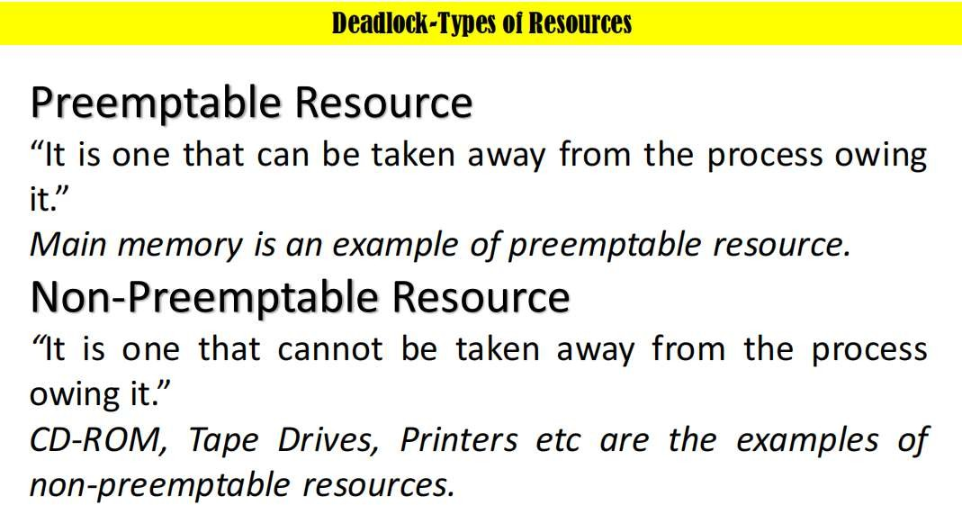

Slide 8
Sequence of events required to use a resource
Deadlock-Types of Resources
Request the resource
Use the resource
Release the resource
4/7/2023

Slide 9



Deadlock-Resource Acquisition
Process
A
Process
B
R1 Granted
R1, process blocked until available
R2 Granted
Resource 2
Resource 1
4/7/2023

Slide 10
Process
A
Process
B
R1 Denied
R1 Granted
R2 Granted
R2 Denied
Resource 2
Resource 1
07/04/202

Slide 11


Definition
Introduction to Deadlocks
“Two or more processes are interacting, they get themselves into a stalemate situation they cannot get out off.”
No action can be taken
07/04/202

Slide 12
1- Mutual Exclusion Condition
Introduction to Deadlocks-Conditions for Deadlock
“Only one process at a time can use the resource.”
If other process requests that resource, the requesting process must be
blocked until the resource has been released.
Hold and Wait Condition
“Processes currently holding resources can request new resources while
waiting for that resource which is held by other process.”
Non-Preemptive Condition
“Resources already allocated to a process cannot be taken away.”
Circular Wait Condition
“There must be a circular chain of two or more processes, each is waiting
for the resource held by the next process.”
07/04/202

Slide 13


Which condition of deadlock is this?
Process
A
Process
B
R1 Granted
R1, process blocked until available
R2 Granted
Resource 2
Resource 1
07/04/202

Slide 14

Process
A
Process
B
Resource cannot
taken away
Resource cannot
taken away
07/04/202

Slide 15

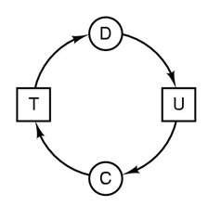
Introduction to Deadlocks-Conditions for Deadlock
07/04/202

Slide 16



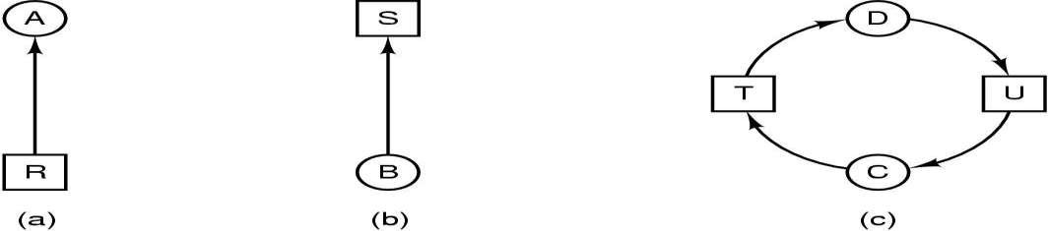
Resource Allocation Graph
Resource R assigned to process A
Process B is requesting/waiting for resource S
Process C and D are in deadlock over resources T and U
16

Slide 17
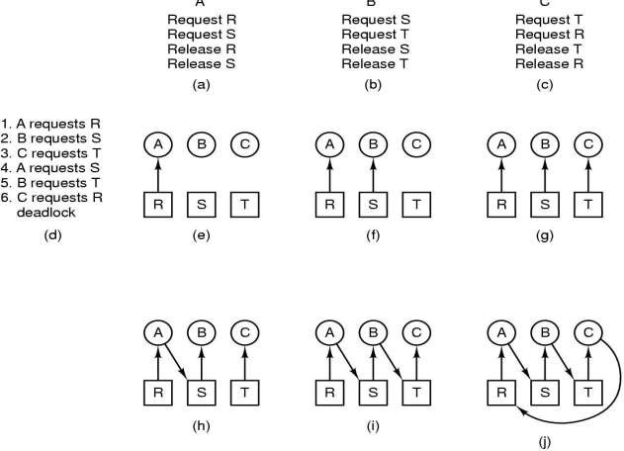
Introduction to Deadlocks-Deadlock Modeling
Class Work 1-Draw a circular chain of picture (j).
07/04/202

Slide 18
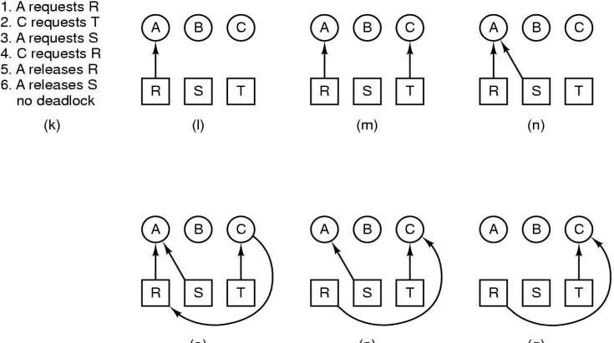
Introduction to Deadlocks-Deadlock Modeling
07/04/202

Slide 19
A visual ( mathematical ) way to determine if a deadlock has, or may occur.
G = ( V, E ) The graph contains nodes and edges.
V Nodes consist of processes = { P1, P2, P3, ...} and resource types
{ R1, R2, ...}
E Edges are ( Pi, Rj ) or ( Ri, Pj )
An arrow from the process to resource indicates the process is requesting the resource.
An arrow from resource to process shows an instance of the resource has been allocated to the process.
Process is a circle, resource type is square; dots represent number of instances of resource in type. Request points to square, assignment comes from dot.
P_{i}
P_{i}
P_{i}
R_{j}
07/04/202

Slide 20
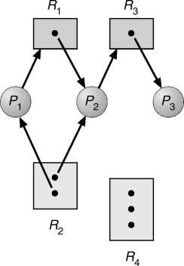
If the graph contains no cycles, then no process is
deadlocked. If there is a cycle, then:
If resource types have multiple instances, then deadlock MAY exist.
If each resource type has 1 instance, then deadlock has occurred.
R3 Assigned to P3
Resource allocation graph
P2 Requests R3
07/04/202

Slide 21
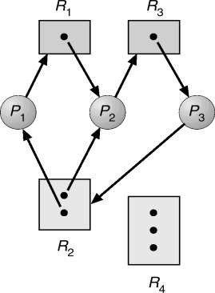
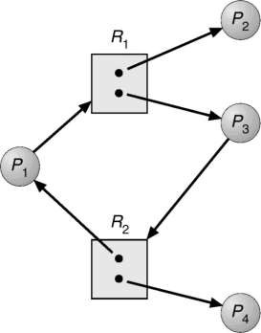
Resource allocation graph
with a deadlock.
Resource allocation graph
with a cycle but no deadlock.
07/04/202

Slide 22
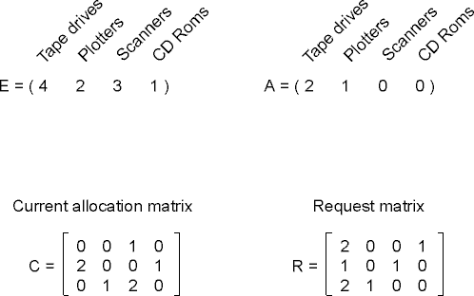
Deadlock Avoidance Algorithm Safe and Unsafe States
At any instant of time, there is a current state consisting of E, A, C and R.

Slide 23
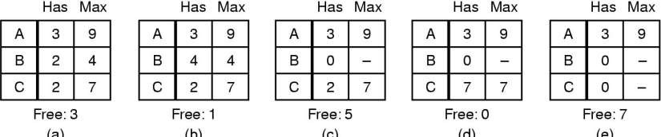
Deadlock Avoidance Algorithm Safe and Unsafe States
A state is said to be Safe if it is not deadlocked and there is some scheduling order in which every process can run to completion.
OR
Safe state is that in which system can guarantee that all
processes will finish.

Slide 24
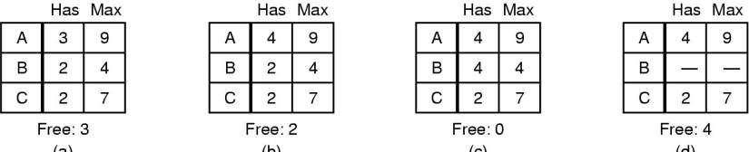
Deadlock Avoidance Algorithm Safe and Unsafe States
A state is said to be Un-safe if it is deadlocked and there is some
scheduling order in which every process cannot run to completion.
OR
Un-safe state is that in which system cannot guarantee that all
processes will finish.

Slide 25
Graph-theoretic models
Wait-for graph.
Resource-allocation graph.

Slide 26
Wait-for graph
P2
P1
P3
P5
P4

Slide 27

Resource allocation graph
P1
P2
P1
P2
r1
r2
P3
Resource allocation graph Without deadlock
P3
With deadlock

Slide 28


Wait-for graph and Resource-allocation graph conversion
Any resource allocation graph with a single copy of resources can be transferred to a wait-for graph.
P1
P1
P3
P2
P3
P2

Slide 29
Strategies for handling deadlocks
Deadlock prevention: Prevents deadlocks by restraining requests made to ensure that at least one of the four deadlock conditions cannot occur.
Deadlock avoidance: Dynamically grants a
resource to a process if the resulting state is safe. A state is safe if there is at least one execution sequence that allows all processes to run to completion.
Deadlock detection and recovery: Allows deadlocks to form; then finds and breaks them.

Slide 30
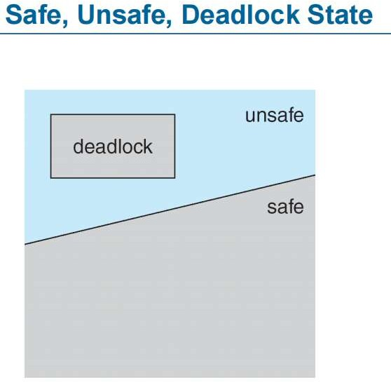
Avoidance algorithms
Single instance of a resource type
Use a resource-allocation graph
Multiple instances of a resource type Use the banker’s algorithm

Slide 31
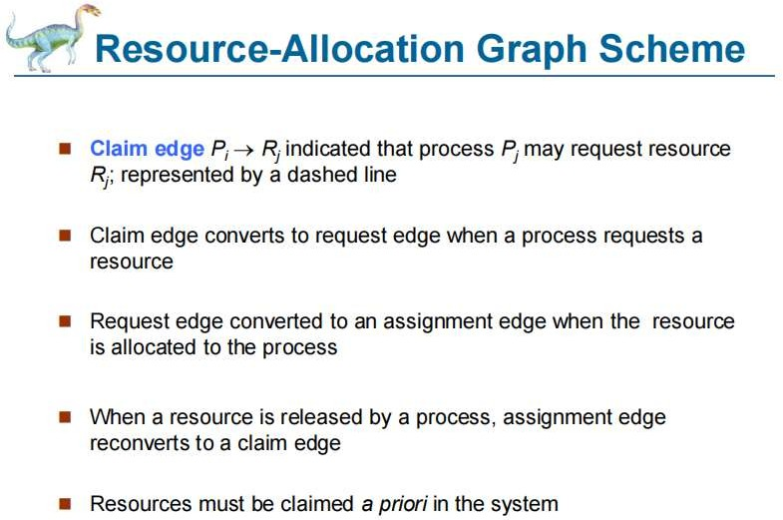

Slide 32
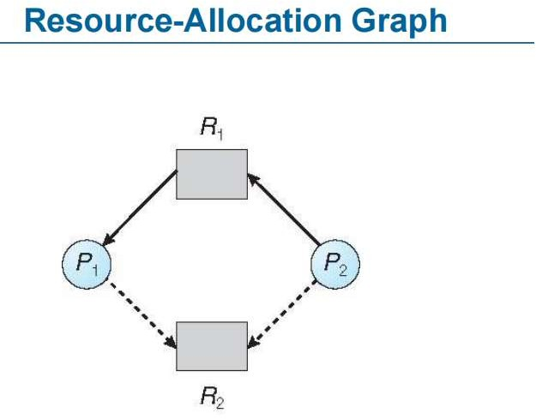

Slide 33
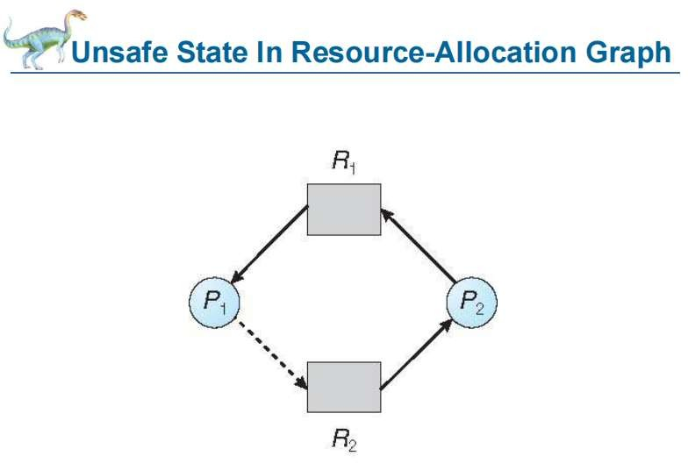

Slide 34
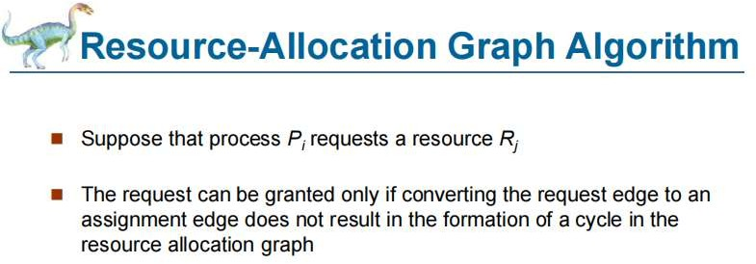

Slide 35
Deadlock-Avoidance
Banker’s Algorithm for a Single
Resource
Banker’s algorithm considers each request as it occurs, and see if granting it leads to a safe state, if it does, the request is granted otherwise denied.

Slide 36
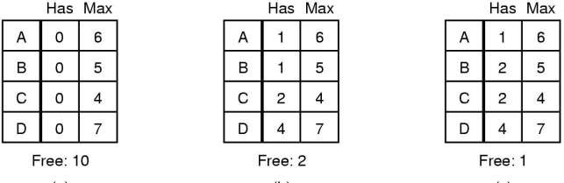
Banker’s Algorithm for a Single Resource
Banker’s algorithm is used to check which state is safe and
which one is un-safe.
This state is safe because with 2 resources left the process can delay any requests except C’s, thus letting C finish and release all four of its resources. With four resources in hand, the process can let either D or B have the necessary resources and so on.

Slide 37
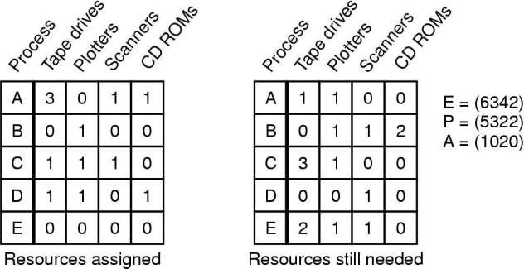
Banker’s Algorithm for Multiple Resources
P=Possessed resources
E=Existing resources (total resources)
A=Available resources
Need[i][j] = Max[i][j] - Allocation [i][j]

Slide 38
Banker’s Algorithm for Multiple
Resources
ALGORITHM:
If (Need[i] ≤ Available)
Then Available= Available + Allocation[i];
if no such row exists, we are deadlocked because no process can acquire the resources it needs to run to completion.
  If there's more than one such row, just pick one.
Repeat 1 and 2 until all processes are either virtually terminated (safe
state), or a deadlock is detected (unsafe state).

Slide 39
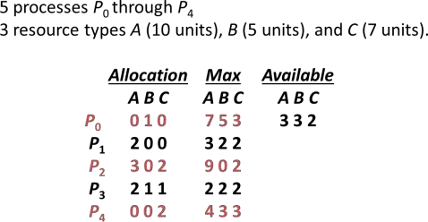
CLASS EXERCISE-1
Find safe sequence?
Total=[10,5,7]

Slide 40
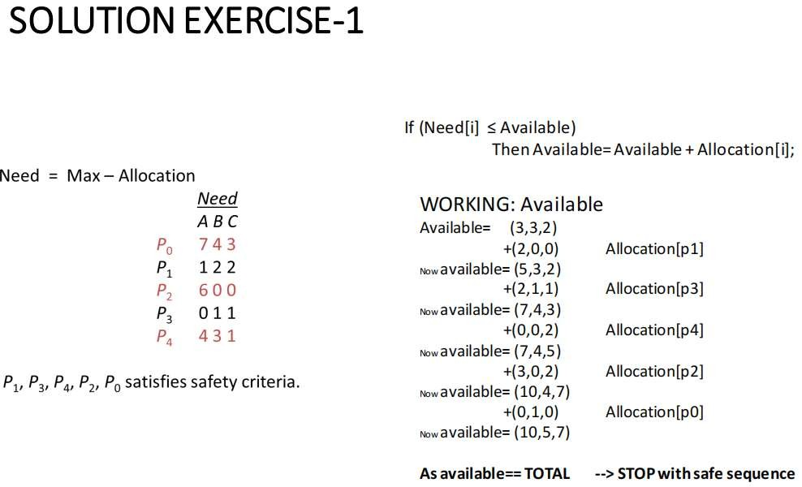

Slide 41
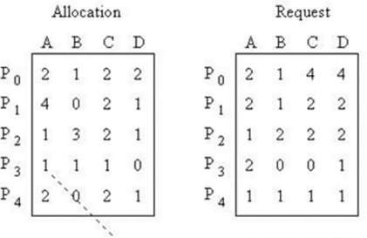

Class Exercise: 2
Total Matrix?
MAX matrix for each process
If any safe sequence exist? Find.

Slide 42
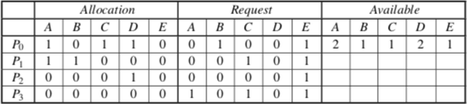
Sample Question-1 with sol
Consider the following snapshot of a system in which five resources A, B, C, D and E are available. The system contains a total of 2 instances of A, 1 of resource B, 1 of resource C, 2 resource D and 1 of resource E.
Do the following problems:
Convert this matrix representation to a resource allocation graph.
Use the deadlock detection algorithm to determine whether the system contains a
deadlock. Which processes are involved in the deadlock?
While you are use the deadlock detection algorithm, add and remove directed
edges of the re- source allocation graph.

Slide 43
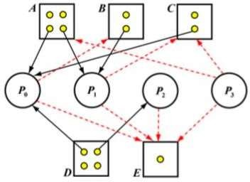
1.Answer: The corresponding resource allocation graph is shown below:
1.Note that red dashed-lined arrows are used to indicate unsatisfied “requests”

Slide 44
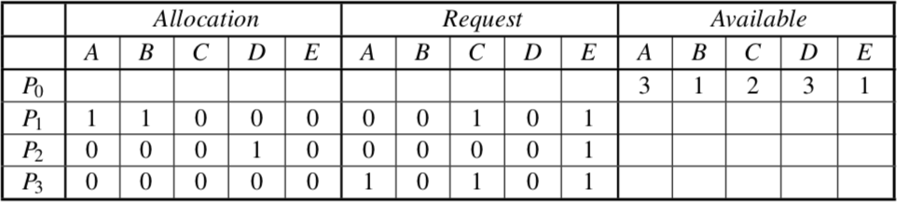
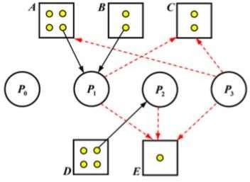
Currently, because P0′s Request=[0,1,0,0,1]≤Available=[2,1,1,2,1],we run P0 and reclaim its Allocation, and the new Allocation = Old Allocation + Available = [1, 0, 1, 1, 0] + [2, 1, 1, 2, 1] = [3, 1, 2, 3, 1]. The new matrix representation becomes:
For the resource allocation graph, because all resources allocated to P0 are returned and P0 has no new request (so far), the new graph is obtained by removing all request edges and allocation edges as shown below:

Slide 45
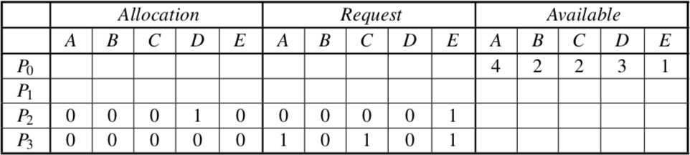
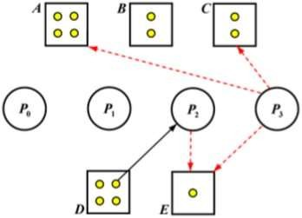
Now, we have P1′s Request = [0,0,1,0,1] ≤ Available = [3,1,2,3,1]. We can run P1, and reclaim
its Allocation=[1,1,0,0,0]. The new Available=[3,1,2,3,1]+P′s Allocation=[1,1,0,0,0]= [4, 2, 2, 3, 1]. As a
result, the new matrix representation is:
By removing all edges of P1 yields a new resource allocation graph:

Slide 46
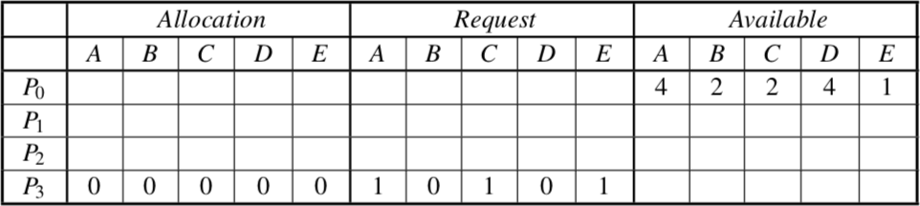
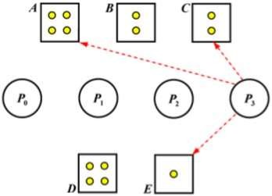
Next, we run P2 and the new matrix representation and resource allocation graph are:
Removing all edges from and to P1 yields a new resource allocation graph:
Finally, P3 can run and return all of its resources. Because all involved processes are finished, this system does not have a deadlock.
Safe Sequence= <P0,P1,P2,P3>

Slide 47
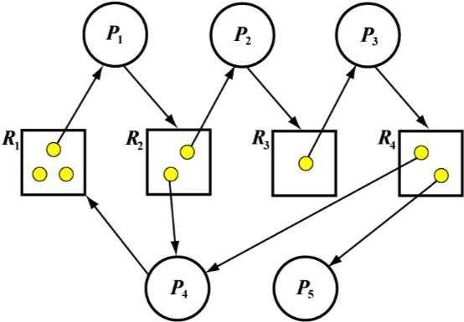
Sample Question-2 with sol
Consider the following resource allocation
graph.
Do the following problems:
Convert it to the matrix representation (i.e., Allocation, request and Available).
Do a step-by-step execution of the deadlock detection algorithm. For each step, add and remove the directed edges, and redraw the resource allocation graph.
Is there a deadlock? If there is a deadlock, which processes are involved?

Slide 48
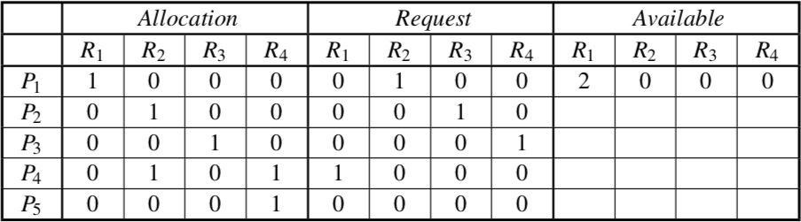
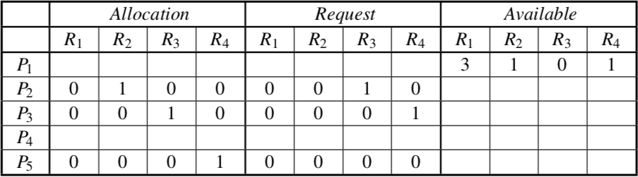
Answer: The matrix representation of the given resource allocation graph is shown below:
Because P4′sRequest=[1,0,0,0]≤Available=[2,0,0,0],P4 runs and returns is Allocation=[0,1,0,1] making
the new Available = [2, 0, 0, 0] + [0, 1, 0, 1] = [2, 1, 0, 1]. The matrix representation becomes:

Slide 49
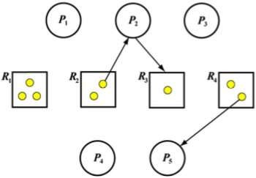
Here is the corresponding resource allocation graph:

Slide 50
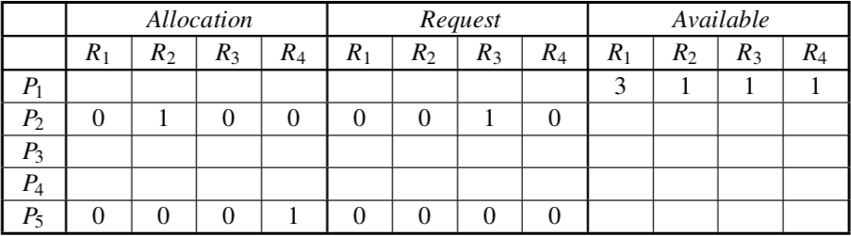
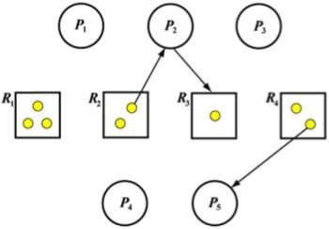
The next process is P3 because P3’sRequest=[0,0,0,1]≤Available=[3,1,0,1].After P3 finishes its work,
its Allocation = [0, 0, 1, 0] is returned to Available = [3, 1, 0, 1] + [0, 0, 1, 0] = [3, 1, 1, 1]:
The resource allocation graph is shown below:

Slide 51
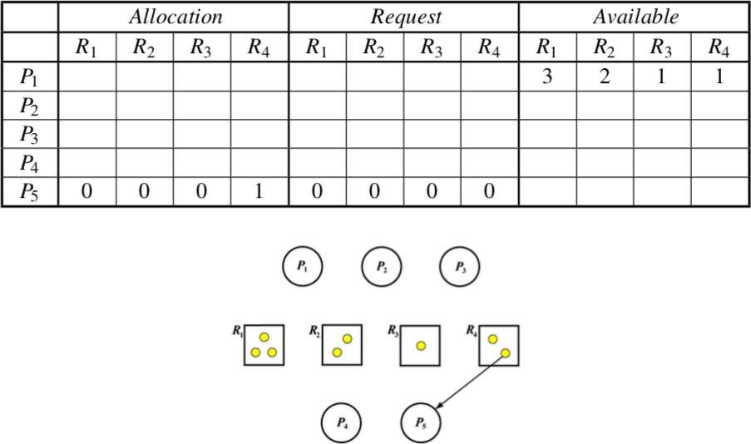
Now we can run P2 and the yields (i.e., matrix representation and resource allocation graph) are:
Finally, we can run P5 and all processes are done! Note that there are cycles P1 → R2 → P4 → R1 → P1 and P1 → R2 → P2 → R3 → P3 → R4 → P4 → R1 → P1. However, there is no deadlock.
SAFE SEQUENCE<P4,P1,P3,P2,P5>

Slide 52
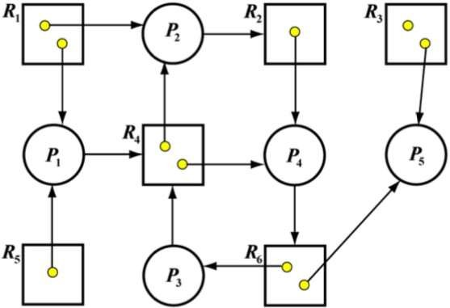
EXERCISE QUESTION:
Consider the following resource allocation graph.
Do the following problems:
Convert it to the matrix representation(i.e., Allocation, Request and Available).
Do a step-by-step execution of the deadlock detection algorithm. For each step, add and remove the directed edges, and redraw the resource allocation graph.
Is there a deadlock? If there is a deadlock, which processes are involved?

Slide 53
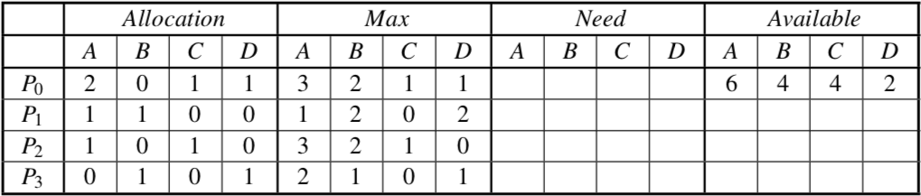
EXERCISE QUESTION:
Consider the following snapshot of a system in which four resources A, B, C and D area available.
The system contains a total of 6 instances of A, 4 of resource B, 4 of resource C, 2 resource D.
Convert this matrix representation to a resource allocation graph. Do the following problems using the banker’s algorithm:
Compute what each process might still request and fill this in under the column Need. • Is the system
in a safe state? Why or why not?
Is the system deadlocked? Why or why not?
If a request from P3 arrives for (2, 1, 0, 0), can the request be granted immediately?

Slide 54
Resource-Request Algorithm
1. If Requesti <= Needi
Goto step (2) ; otherwise, raise an error condition, since the process has exceeded its maximum claim.
2. If Requesti <= Available
Goto step (3); otherwise, Pi must wait, since the resources are not available.
3. Have the system pretend to have allocated the requested resources to process Pi by modifying the state as
follows:
Available = Available – Requesti
Allocationi = Allocationi + Requesti
Needi = Needi– Requesti

Slide 55
Q.1 What will be the content of the Need matrix?
Need [i, j] = Max [i, j] – Allocation [i, j]
So, the content of Need Matrix is:

Slide 56


Q.2 Is the system in a safe state? If Yes, then what is the safe sequence?
Applying the Safety algorithm on the given system,
Q.3 What will happen if process P1 requests one additional instance of resource type A and two instances of resource type C?

Slide 57
Q:4 If the request from P4 arrives for (0,0,2) can it be immediately granted?
Ans: No, Deadlock. Check it by running the resource-request algorithm.

Slide 58
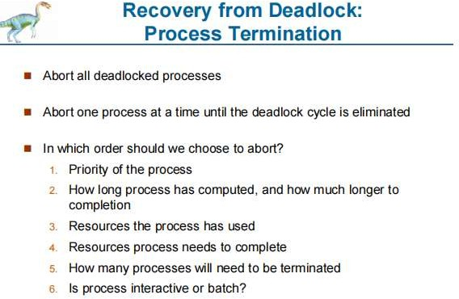

Slide 59
